Slide 1

You will also find that there are some duplicates of certain slides. This is on-purpose and allows the presentation to be used in a number of different settings:
In-person
Sent by email
Printed
Depending on your intended use, you can delete the other slides as needed, including this one.
Thank you!
professional
equity assessment report Template
Thanks for downloading the Professional Equity Assessment Report Template. In this file, you will find an editable PowerPoint presentation that you can present to your clients.
Throughout the document, you will find many different areas you can personalize it to your brand. Swap out logos, images and input the seller’s name and address for a customizable PEAR presentation.
YOUR WEBSITE URL

Slide 2
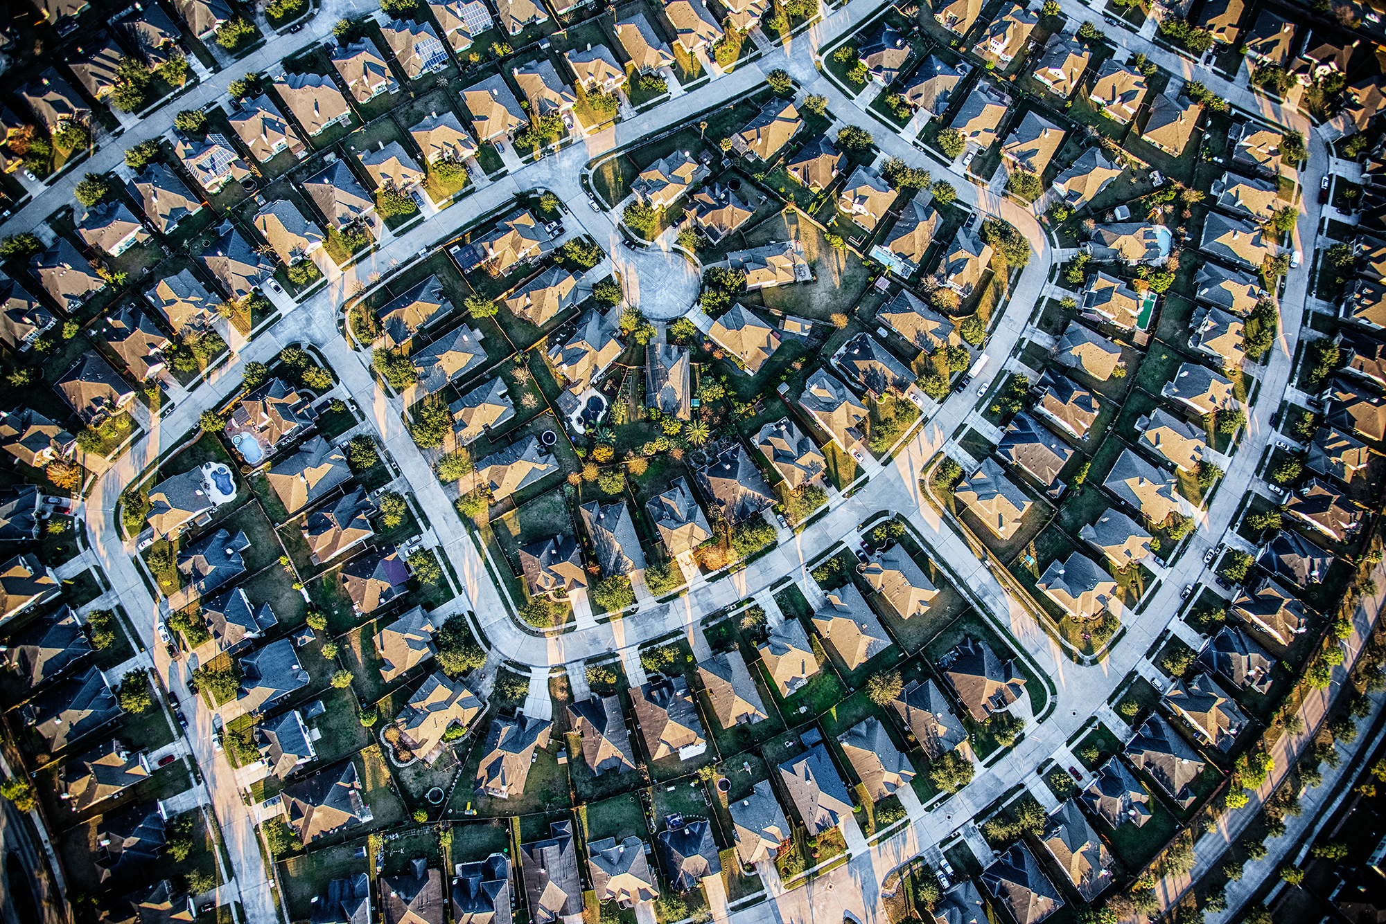

YOUR LOGO
PROFESSIONAL
EQUITY ASSESSMENT REPORT
Client Name
Client Address

Slide 3


WHAT IS A PROFESSIONAL
EQUITY ASSESSMENT REPORT?
A Professional Equity Assessment Report (PEAR) is a custom evaluation
of your home’s cash value. By knowing what you currently owe on your mortgage and estimating the value of your home, we can determine your home’s approximate equity. This is a powerful tool to help you make confident decisions in your home selling process.

Slide 4
YOUR LOGO
Estimated Home Value
Name of Client
Client’s Address
$250,000
Your home’s professional equity assessment report
Mortgage Balance
$150,000
Let’s take a look at the numbers to see how much equity you have in your home.
Equity Estimate
$100,000
YOUR WEBSITE URL

Slide 5


YOUR LOGO
Let’s talk Next steps
I’m sure you have questions.
I would love to talk with you about your equity estimate and discuss next steps in your home selling process.
Your Name
Your Title
Your Brokerage
Your Email
Your Phone Number
+62 123 456 789
INSERT YOUR PHOTO
YOUR WEBSITE URL

Slide 6
YOUR LOGO
Let’s talk
Next steps!
Your Name
Your Title
Your Brokerage
Your Email
Your Phone Number
+62 123 456 789
YOUR WEBSITE URL

Slide 7
YOUR LOGO
Let’s talk
Next steps!
+62 123 456 789
YOUR WEBSITE URL

Slide 8
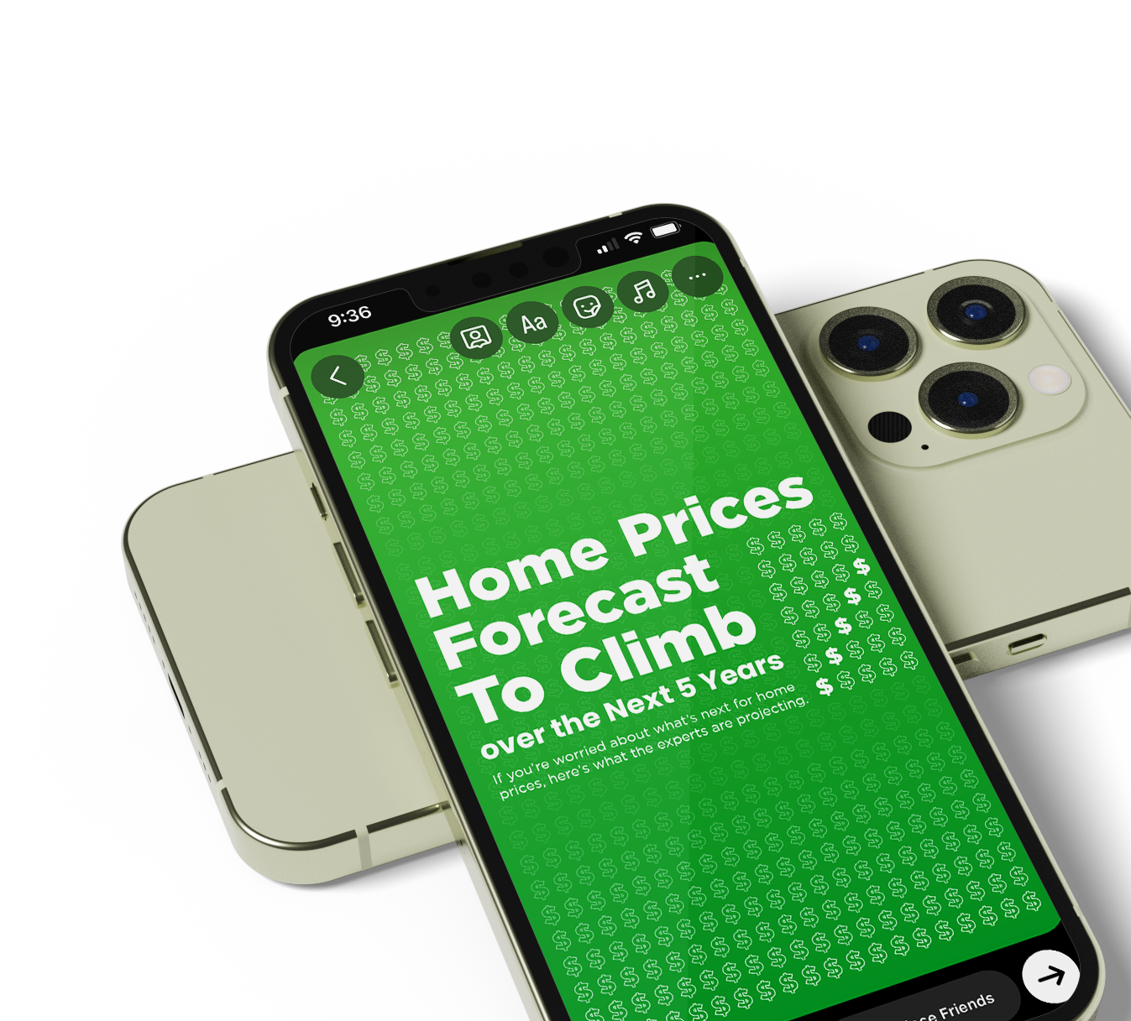
www.keepingcurrentmatters.com
THANK YOU!
We hope you enjoy your Professional Equity Assessment Report template.

