Slide 1


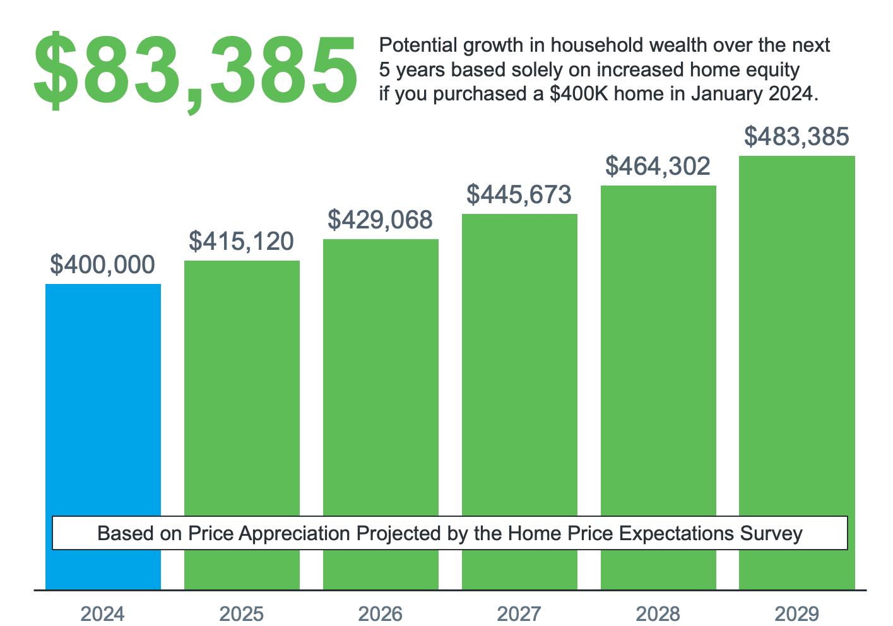

Top 5
Slides
YOUR SPRING MARKET
MESSAGING PLAYBOOK

Slide 2
New Listings Above Last Year’s Level
April of Each Year
Source: Realtor.com
Notes:
https://www.realtor.com/research/data/

Slide 3
2024 Home Price Forecasts
Percent Appreciation/Depreciation as of 5/1/2024
Notes:
https://www.goldmansachs.com/intelligence/pages/us-home-prices-forecast-to-climb-as-mortgage-rates-fall-in-2024.html
https://img03.en25.com/Web/MortgageBankersAssociation/%7B3a3cfcd7-a920-4329-8953-167a89666546%7D_Mortgage_Finance_Forecast_Apr_2024.pdf
https://www.zillow.com/research/home-value-sales-forecast-33822/
https://www.fanniemae.com/media/50986/display
https://www.freddiemac.com/research/forecast/20240418-economic-growth-moderated-labor-market-robust
https://pulsenomics.com/surveys/
https://www.nar.realtor/newsroom/pending-home-sales-ascended-3-4-in-march

Slide 4
Estimated Home Price Performance
December–December, as Forecast in Q1 2024
Recovery
To Date
Pre-Bubble
Bubble
Bust
Source: HPES
Notes:
https://pulsenomics.com/surveys/#home-price-expectations

Slide 5
Potential growth in household wealth over the next
5 years based solely on increased home equity if you purchased a $400K home in January 2024.
$83,385
Recovery
To Date
Pre-Bubble
Bubble
Bust
Based on Price Appreciation Projected by the Home Price Expectations Survey
Source: HPES
Notes:
https://pulsenomics.com/surveys/#home-price-expectations

Slide 6
Mortgage Rate Projections
April 2024
Notes:
https://www.fanniemae.com/media/50986/display
https://img03.en25.com/Web/MortgageBankersAssociation/%7B3a3cfcd7-a920-4329-8953-167a89666546%7D_Mortgage_Finance_Forecast_Apr_2024.pdf
https://cdn.nar.realtor/sites/default/files/documents/forecast-q2-2024-us-economic-outlook-04-25-2024.pdf

Slide 7
Demand Based on Rate Environment
Buyer Demand
Weak
Limited
Good
Strong
Mortgage News Daily Rate: 30-Year Fixed Rate in 2024
Source: KCM Analysis, Mortgage News Daily
Notes:
https://www.mortgagenewsdaily.com/mortgage-rates

